Slide 1
BANK LOAN ANALYSIS EXCEL DASHBOARD
PRESENTED BY
Shivanand Satyappa Nashi
For more details , please visit
https://github.com/Gtshivanand

Slide 2
OBJECTIVE
The main objective of this project is to analyse the loan data to understand the characteristics and patterns of loan applications and their outcomes. The analysis also aims to identify key factors that influence the likelihood of loan repayment or default, and understand how variables such as loan amount, interest rate, employment history, and creditworthiness (as indicated by factors like annual income and credit account history) predict the performance of loans. This insight can inform risk management strategies and lending policies to optimize the lending process and minimize defaults.

Slide 3
ABOUT DATASET
The document contains information about various individuals who have taken out car loans, detailing their employment status, loan status, loan amount, and payment history. The loans have varying terms, ranging from 36 to 60 months, and interest rates from 5.42% to 24.59%. Some individuals have fully paid off their loans, while others have had their loans charged off. The document provides a snapshot of the loan performance of different borrowers across different states and employment lengths. The dataset has 38,576 entries (loan records) and 24 columns (attributes).

Slide 4
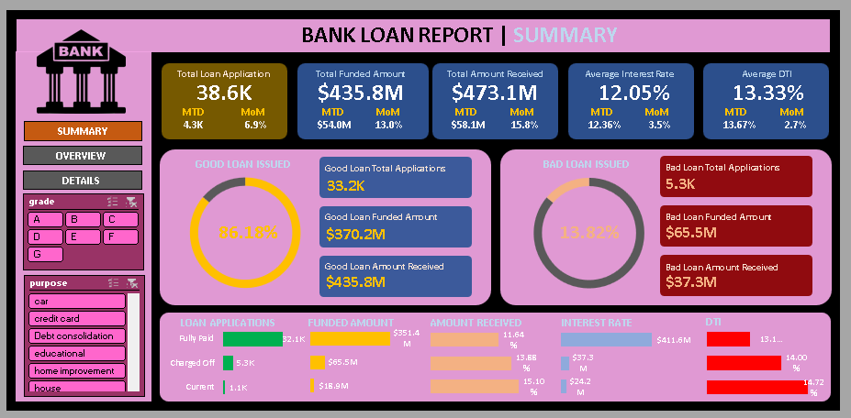
DASHBOARDS

Slide 5
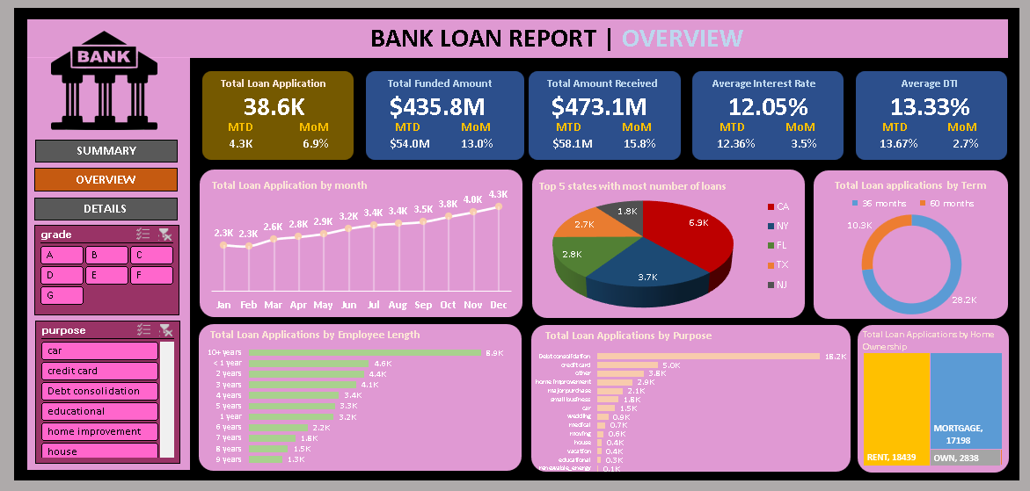

Slide 6
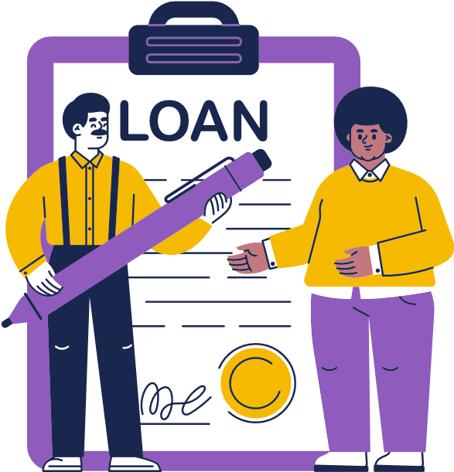
KEY PERFORMANCE INDICATORS (KPI)
Total Loan Applications:
We need to calculate the total number of loan applications received during a specified period. Additionally, it is essential to monitor the Month-to-Date (MTD) Loan Applications and track changes Month-over-Month (MoM).
Total Funded Amount:
Understanding the total amount of funds disbursed as loans is crucial. We also want to keep an eye on the MTD Total Funded Amount and analyse the Month-over-Month (MoM) changes in this metric.

Slide 7
Total Amount Received:
Tracking the total amount received from borrowers is essential for assessing the bank's cash flow and loan repayment. We should analyse the Month-to-Date (MTD) Total Amount Received and observe the Month-over-Month (MoM) changes.
Average Interest Rate:
Calculating the average interest rate across all loans, MTD, and monitoring the Month-over-Month (MoM) variations in interest rates will provide insights into our lending portfolio's overall cost.
Average Debt-to-Income Ratio(DTI):
Evaluating the average DTI for our borrowers helps us gauge their financial health. We need to compute the average DTI for all loans, MTD, and track Month-over-Month (MoM) fluctuations.

Slide 8
GOOD LOAN VS BAD LOAN
GOOD LOAN | BAD LOAN
Good Loan Application Percentage:86.18% | Bad Loan Application Percentage:13.83%
Good Loan Application: 33.2 K | Bad Load Application: 5.3 K
Good Loan Funded Amount : $370.2 M | Bad Loan Funded Amount: $65.5 M
Good Loan Received Amount: $ 435.8 M | Bad Loan Received Amount: $37.3M
Based on the Data provided, the bank is in provided ,the bank is in Profit.

Slide 9
RECOMMONDATIONS
Identify Risk Factors: Review the characteristics of bad loan applications to identify common risk factors such as low credit scores, high debt-to-income ratios, or unstable employment histories.
Enhance Underwriting Criteria: Strengthen underwriting criteria to mitigate risks associated with bad loans. This may include setting minimum thresholds for credit scores, debt-to-income ratios, or employment stability.
Improve Verification Processes: Implement robust verification processes to ensure the accuracy of applicant information, including income verification, employment verification, and identity verification.

Slide 10
Improve Verification Processes: Implement robust verification processes to ensure the accuracy of applicant information, including income verification, employment verification, and identity verification.
Monitor and Manage Portfolio: Continuously monitor the loan portfolio performance and identify early warning signs of potential defaults. Implement proactive measures such as loan restructuring or collections strategies to minimize losses.

